Slide 1
Basic Business Statistics
11th Edition
Chapter 5
Some Important Discrete Probability Distributions

Slide 2
Learning Objectives
In this chapter, you learn:
The properties of a probability distribution
To calculate the expected value and variance of a probability distribution
To calculate the covariance and understand its use in finance
To calculate probabilities from binomial, hypergeometric, and Poisson distributions
How to use the binomial, hypergeometric, and Poisson distributions to solve business problems

Slide 3
Definitions
Random Variables
A random variable represents a possible numerical value from an uncertain event.
Discrete random variables produce outcomes that come from a counting process (e.g. number of classes you are taking).
Continuous random variables produce outcomes that come from a measurement (e.g. your annual salary, or your weight).

Slide 4
Definitions
Random Variables
Definitions
Random Variables
Definitions
Random Variables
Random
Variables
Random
Variables
Random
Variables
Ch. 5
Ch. 5
Ch. 5
Ch. 6
Ch. 6
Discrete
Random Variable
Ch. 6
Discrete
Random Variable
Discrete
Random Variable
Continuous
Random Variable
Continuous
Random Variable
Continuous
Random Variable

Slide 5

Discrete Random Variables
Can only assume a countable number of values
  Examples:
  Roll a die twice
Let X be the number of times 4 occurs
(then X could be 0, 1, or 2 times)
  Toss a coin 5 times.
  Let X be the number of heads
  (then X = 0, 1, 2, 3, 4, or 5)

Slide 6
Probability Distribution For A Discrete Random Variable
A probability distribution for a discrete random variable is a mutually exclusive listing of all possible numerical outcomes for that variable and a probability of occurrence associated with each outcome.
Number of Classes Taken | Probability
2 | 0.2
3 | 0.4
4 | 0.24
5 | 0.16

Slide 7
Example of a Discrete Random Variable Probability Distribution
Experiment: Toss 2 Coins. Let X = # heads.
4 possible outcomes
Probability Distribution
T
T
X Value Probability
0 1/4 = 0.25
1 2/4 = 0.50
2 1/4 = 0.25
T
H
H
T
0.50
0.25
Probability
H
H
0 1 2 X

Slide 8
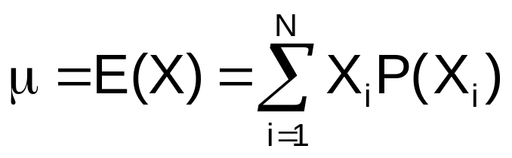
Discrete Random Variables
Expected Value (Measuring Center)
Expected Value (or mean) of a discrete
random variable (Weighted Average)
  Example: Toss 2 coins,
  X = # of heads,
  compute expected value of X:
E(X) = ((0)(0.25) + (1)(0.50) + (2)(0.25))
= 1.0
X P(X)
0 0.25
1 0.50
2 0.25

Slide 9
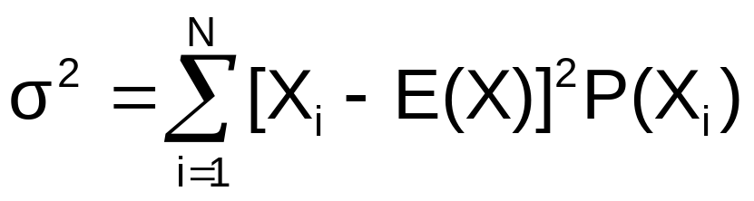
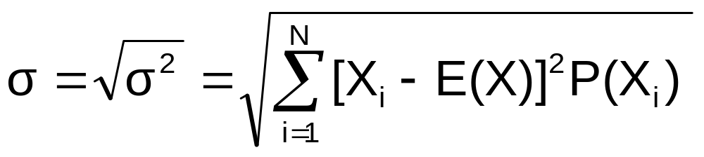
Discrete Random Variables
Measuring Dispersion
Variance of a discrete random variable
Standard Deviation of a discrete random variable
where:
E(X) = Expected value of the discrete random variable X
X_{i} = the i^{th} outcome of X
P(X_{i}) = Probability of the i^{th} occurrence of X

Slide 10
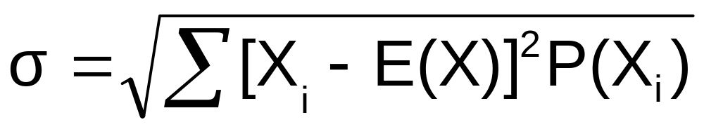
Discrete Random Variables
Measuring Dispersion
(continued)
  Example: Toss 2 coins, X = # heads,
  compute standard deviation (recall E(X) = 1)
Possible number of heads = 0, 1, or 2

Slide 11
Covariance
The covariance measures the strength of the linear relationship between two discrete random variables X and Y.
A positive covariance indicates a positive relationship.
A negative covariance indicates a negative relationship.

Slide 12
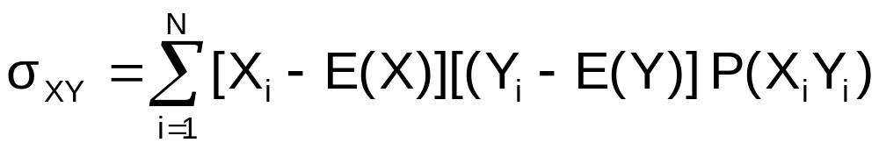
The Covariance Formula
The covariance formula:
where: X = discrete random variable X
X_{i} = the i^{th} outcome of X
Y = discrete random variable Y
Y_{i} = the i^{th} outcome of Y
P(X_{i}Y_{i}) = probability of occurrence of the
i^{th} outcome of X and the i^{th} outcome of Y

Slide 13
Investment Returns
The Mean
Consider the return per $1000 for two types of investments.
Economic Condition Prob. | Investment
 | Passive Fund X | Aggressive Fund Y
0.2 Recession | - $25 | - $200
0.5 Stable Economy | + $50 | + $60
0.3 Expanding Economy | + $100 | + $350

Slide 14
Investment Returns
The Mean
E(X) = μ_{X} = (-25)(.2) +(50)(.5) + (100)(.3) = 50
E(Y) = μ_{Y} = (-200)(.2) +(60)(.5) + (350)(.3) = 95
Interpretation: Fund X is averaging a $50.00 return and fund Y is averaging a $95.00 return per $1000 invested.

Slide 15
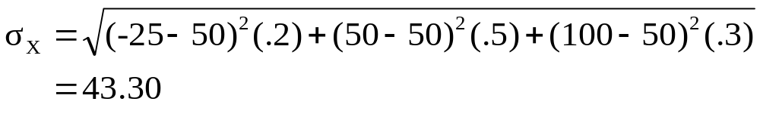
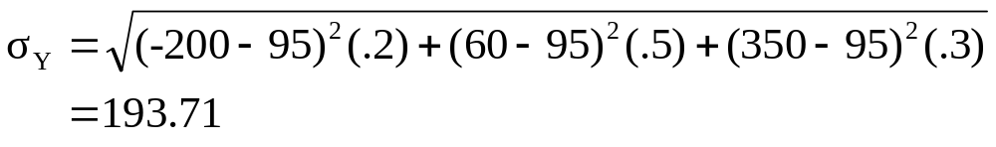
Investment Returns
Standard Deviation
Interpretation: Even though fund Y has a higher average return, it is subject to much more variability and the probability of loss is higher.

Slide 16
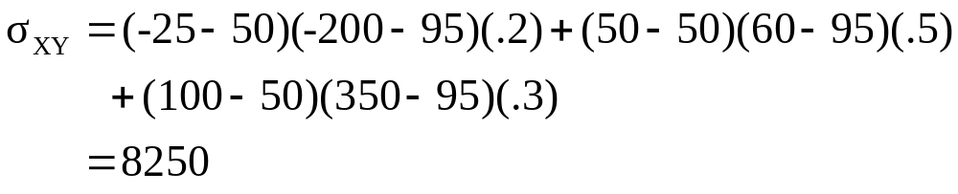
Investment Returns
Covariance
Interpretation: Since the covariance is large and positive, there is a positive relationship between the two investment funds, meaning that they will likely rise and fall together.

Slide 17
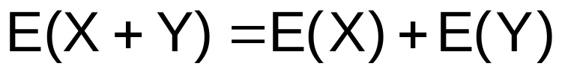
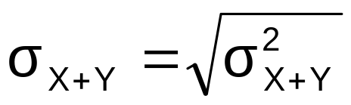
The Sum of
Two Random Variables
Expected Value of the sum of two random variables:
Variance of the sum of two random variables:
Standard deviation of the sum of two random variables:

Slide 18
Portfolio Expected Return and Expected Risk
Investment portfolios usually contain several different funds (random variables)
The expected return and standard deviation of two funds together can now be calculated.
Investment Objective: Maximize return (mean) while minimizing risk (standard deviation).

Slide 19
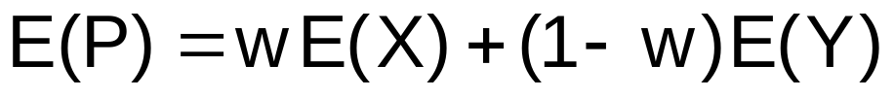
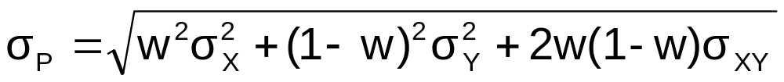
Portfolio Expected Return and Portfolio Risk
Portfolio expected return (weighted average return):
Portfolio risk (weighted variability)
Where w = proportion of portfolio value in asset X
  (1 - w) = proportion of portfolio value in asset Y

Slide 20
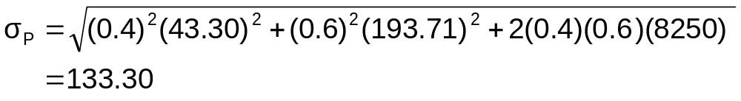
Portfolio Example
Investment X: μ_{X} = 50 σ_{X} = 43.30
Investment Y: μ_{Y} = 95 σ_{Y} = 193.21
σ_{XY} = 8250
Suppose 40% of the portfolio is in Investment X and 60% is in Investment Y:
The portfolio return and portfolio variability are between the values for investments X and Y considered individually

Slide 21
Probability Distributions
Probability Distributions
Ch. 5
Discrete
Probability Distributions
Continuous
Probability Distributions
Ch. 6
Binomial
Normal
Poisson
Uniform
Hypergeometric
Exponential

Slide 22
Binomial Probability Distribution
A fixed number of observations, n
  e.g., 15 tosses of a coin; ten light bulbs taken from a warehouse
Each observation is categorized as to whether or not the “event of interest” occurred
  e.g., head or tail in each toss of a coin; defective or not defective light bulb
  Since these two categories are mutually exclusive and collectively exhaustive
    When the probability of the event of interest is represented as π, then the probability of the event of interest not occurring is 1 - π
Constant probability for the event of interest occurring (π) for each observation
  Probability of getting a tail is the same each time we toss the coin

Slide 23
Binomial Probability Distribution
(continued)
Observations are independent
  The outcome of one observation does not affect the outcome of the other
  Two sampling methods deliver independence
    Infinite population without replacement
    Finite population with replacement

Slide 24
Possible Applications for the Binomial Distribution
A manufacturing plant labels items as either defective or acceptable
A firm bidding for contracts will either get a contract or not
A marketing research firm receives survey responses of “yes I will buy” or “no I will not”
New job applicants either accept the offer or reject it

Slide 25
The Binomial Distribution
Counting Techniques
Suppose the event of interest is obtaining heads on the toss of a fair coin. You are to toss the coin three times. In how many ways can you get two heads?
Possible ways: HHT, HTH, THH, so there are three ways you can getting two heads.
This situation is fairly simple. We need to be able to count the number of ways for more complicated situations.

Slide 26
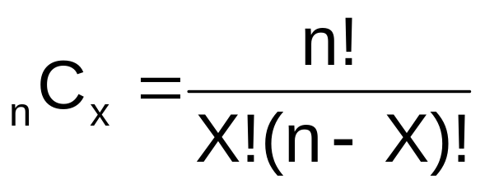
Counting Techniques
Rule of Combinations
The number of combinations of selecting X objects out of n objects is
where:
n! =(n)(n - 1)(n - 2) . . . (2)(1)
X! = (X)(X - 1)(X - 2) . . . (2)(1)
0! = 1 (by definition)

Slide 27
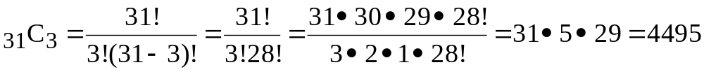
Counting Techniques
Rule of Combinations
How many possible 3 scoop combinations could you create at an ice cream parlor if you have 31 flavors to select from?
The total choices is n = 31, and we select X = 3.

Slide 28
Binomial Distribution Formula
n
!
P(X)
=
X
n
−
X
π
(1-π)
X !
(
−
)
n
X
!
P(X) = probability of X events of interest in n trials, with the probability of an “event of interest” being π for each trial
X = number of “events of interest” in sample,
(X = 0, 1, 2, ..., n)
n = sample size (number of trials
or observations)
π = probability of “event of interest”
Example: Flip a coin four times, let x = # heads:
n = 4
π = 0.5
1 - π = (1 - 0.5) = 0.5
X = 0, 1, 2, 3, 4

Slide 29
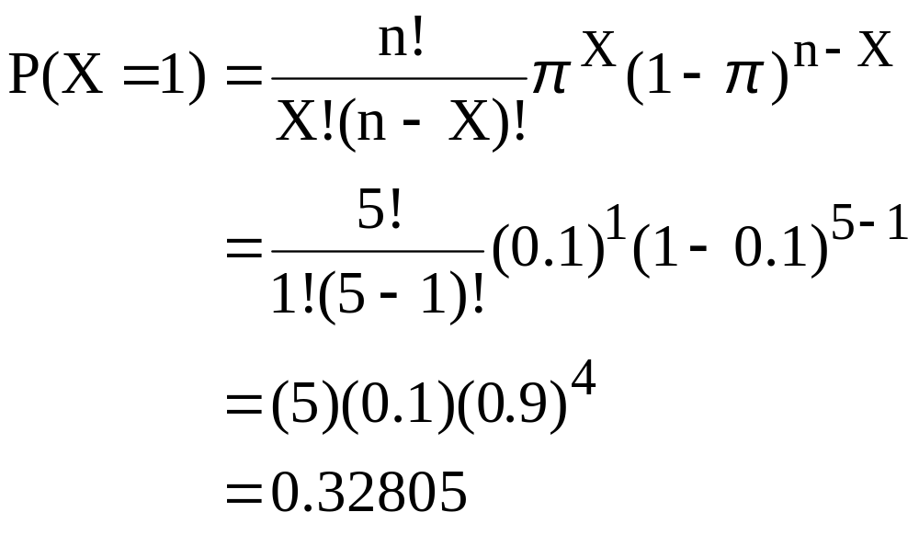
Example:
Calculating a Binomial Probability
What is the probability of one success in five observations if the probability of an event of interest is .1?
X = 1, n = 5, and π = 0.1

Slide 30
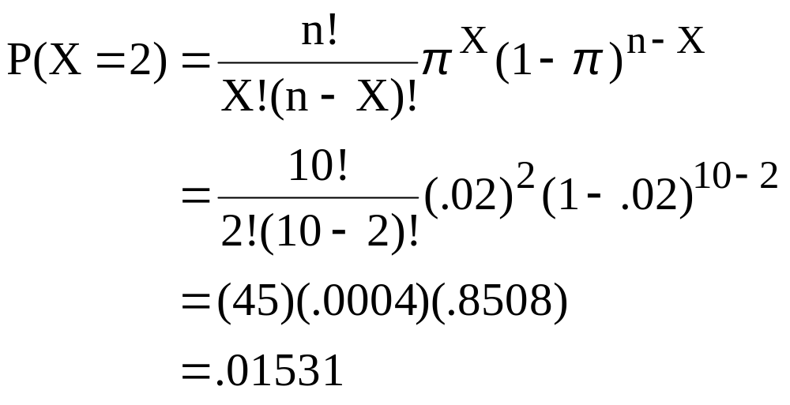
The Binomial Distribution
Example
Suppose the probability of purchasing a defective computer is 0.02. What is the probability of purchasing 2 defective computers in a group of 10?
X = 2, n = 10, and π = .02

Slide 31
The Binomial Distribution
Shape
The shape of the binomial distribution depends on the values of π and n
P(X)
n = 5 π = 0.1
.6
.4
.2
0
Here, n = 5 and π = .1
0
1
2
3
4
5
X
P(X)
n = 5 π = 0.5
.6
.4
.2
Here, n = 5 and π = .5
0
0
1
2
3
4
5
X

Slide 32
The Binomial Distribution
Using Binomial Tables
n = 10
x | … | π=.20 | π=.25 | π=.30 | π=.35 | π=.40 | π=.45 | π=.50
0 1 2 3 4 5 6 7 8 9 10 | … … … … … … … … … … … | 0.1074 0.2684 0.3020 0.2013 0.0881 0.0264 0.0055 0.0008 0.0001 0.0000 0.0000 | 0.0563 0.1877 0.2816 0.2503 0.1460 0.0584 0.0162 0.0031 0.0004 0.0000 0.0000 | 0.0282 0.1211 0.2335 0.2668 0.2001 0.1029 0.0368 0.0090 0.0014 0.0001 0.0000 | 0.0135 0.0725 0.1757 0.2522 0.2377 0.1536 0.0689 0.0212 0.0043 0.0005 0.0000 | 0.0060 0.0403 0.1209 0.2150 0.2508 0.2007 0.1115 0.0425 0.0106 0.0016 0.0001 | 0.0025 0.0207 0.0763 0.1665 0.2384 0.2340 0.1596 0.0746 0.0229 0.0042 0.0003 | 0.0010 0.0098 0.0439 0.1172 0.2051 0.2461 0.2051 0.1172 0.0439 0.0098 0.0010 | 10 9 8 7 6 5 4 3 2 1 0
 | … | π=.80 | π=.75 | π=.70 | π=.65 | π=.60 | π=.55 | π=.50 | x
Examples:
n = 10, π = .35, x = 3: P(x = 3|n =10, π = .35) = .2522
n = 10, π = .75, x = 2: P(x = 2|n =10, π = .75) = .0004

Slide 33
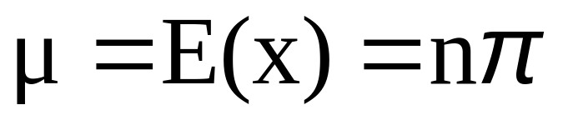
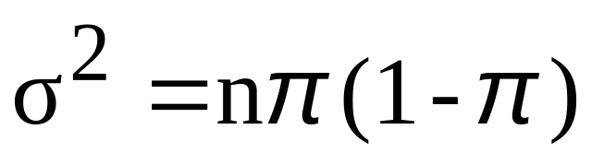
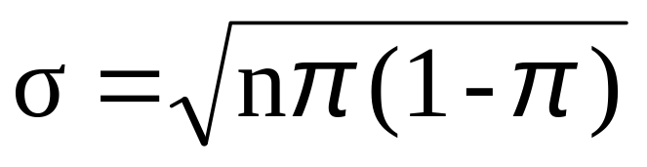
Binomial Distribution Characteristics
Mean
Variance and Standard Deviation
Where n = sample size
π = probability of the event of interest for any trial
(1 – π) = probability of no event of interest for any trial

Slide 34

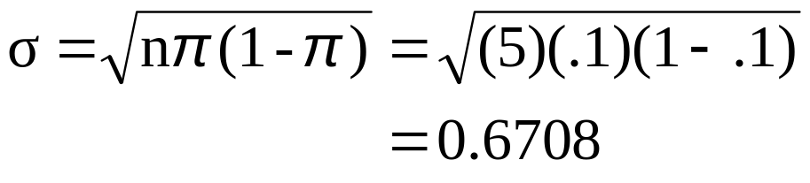

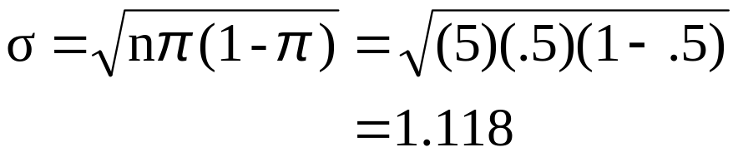
The Binomial Distribution
Characteristics
Examples
P(X)
n = 5 π = 0.1
.6
.4
.2
0
0
1
2
3
4
5
X
P(X)
n = 5 π = 0.5
.6
.4
.2
0
0
1
2
3
4
5
X

Slide 35
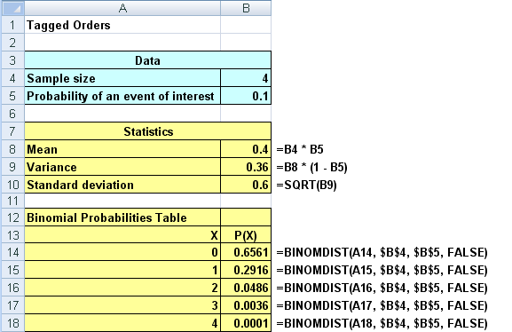
Using Excel For The
Binomial Distribution

Slide 36
The Poisson Distribution
Definitions
You use the Poisson distribution when you are interested in the number of times an event occurs in a given area of opportunity.
An area of opportunity is a continuous unit or interval of time, volume, or such area in which more than one occurrence of an event can occur.
  The number of scratches in a car’s paint
  The number of mosquito bites on a person
  The number of computer crashes in a day

Slide 37
The Poisson Distribution
Apply the Poisson Distribution when:
  You wish to count the number of times an event occurs in a given area of opportunity
  The probability that an event occurs in one area of opportunity is the same for all areas of opportunity
  The number of events that occur in one area of opportunity is independent of the number of events that occur in the other areas of opportunity
  The probability that two or more events occur in an area of opportunity approaches zero as the area of opportunity becomes smaller
  The average number of events per unit is λ (lambda)

Slide 38
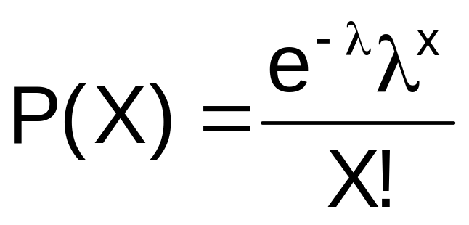
Poisson Distribution Formula
where:
X = number of events in an area of opportunity
λ = expected number of events
e = base of the natural logarithm system (2.71828...)

Slide 39
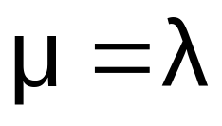
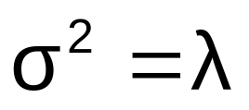
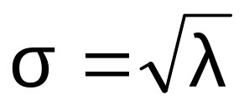
Poisson Distribution Characteristics
Mean
Variance and Standard Deviation
where λ = expected number of events

Slide 40
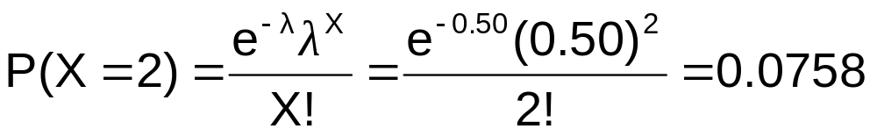
Using Poisson Tables
X | λ
 | 0.10 | 0.20 | 0.30 | 0.40 | 0.50 | 0.60 | 0.70 | 0.80 | 0.90
0 1 2 3 4 5 6 7 | 0.9048 0.0905 0.0045 0.0002 0.0000 0.0000 0.0000 0.0000 | 0.8187 0.1637 0.0164 0.0011 0.0001 0.0000 0.0000 0.0000 | 0.7408 0.2222 0.0333 0.0033 0.0003 0.0000 0.0000 0.0000 | 0.6703 0.2681 0.0536 0.0072 0.0007 0.0001 0.0000 0.0000 | 0.6065 0.3033 0.0758 0.0126 0.0016 0.0002 0.0000 0.0000 | 0.5488 0.3293 0.0988 0.0198 0.0030 0.0004 0.0000 0.0000 | 0.4966 0.3476 0.1217 0.0284 0.0050 0.0007 0.0001 0.0000 | 0.4493 0.3595 0.1438 0.0383 0.0077 0.0012 0.0002 0.0000 | 0.4066 0.3659 0.1647 0.0494 0.0111 0.0020 0.0003 0.0000
Example: Find P(X = 2) if λ = 0.50

Slide 41
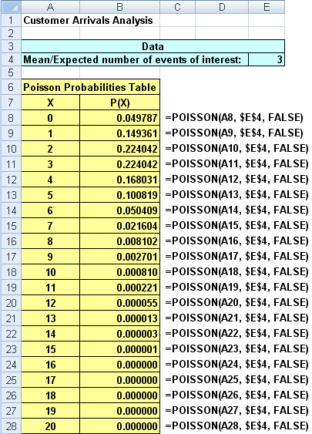
Using Excel For The
Poisson Distribution

Slide 42
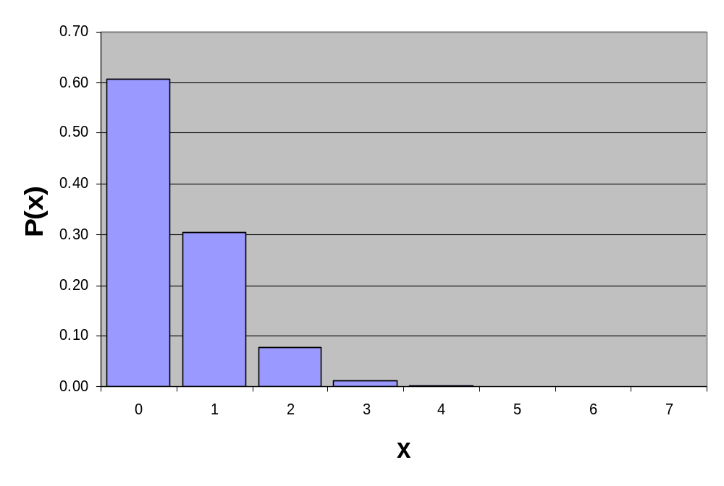
Graph of Poisson Probabilities
Graphically:
λ = 0.50
X | λ = 0.50
0 1 2 3 4 5 6 7 | 0.6065 0.3033 0.0758 0.0126 0.0016 0.0002 0.0000 0.0000
P(X = 2) = 0.0758

Slide 43
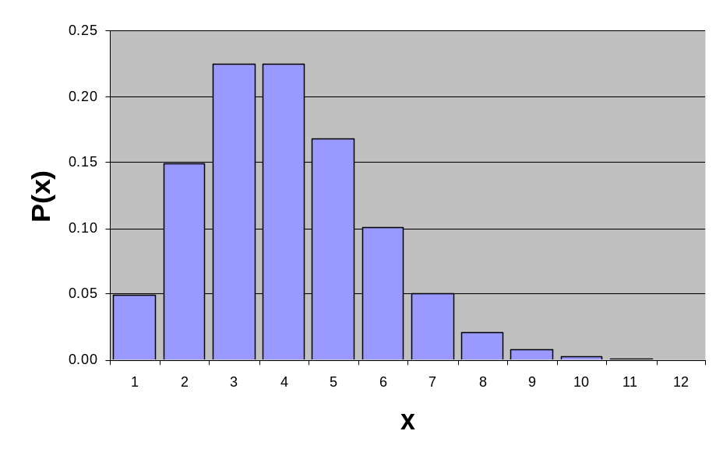
Poisson Distribution Shape
The shape of the Poisson Distribution depends on the parameter λ :
λ = 0.50
λ = 3.00

Slide 44
The Hypergeometric Distribution
The binomial distribution is applicable when selecting from a finite population with replacement or from an infinite population without replacement.
The hypergeometric distribution is applicable when selecting from a finite population without replacement.

Slide 45
The Hypergeometric Distribution
“n” trials in a sample taken from a finite population of size N
Sample taken without replacement
Outcomes of trials are dependent
Concerned with finding the probability of “X” items of interest in the sample where there are “A” items of interest in the population

Slide 46
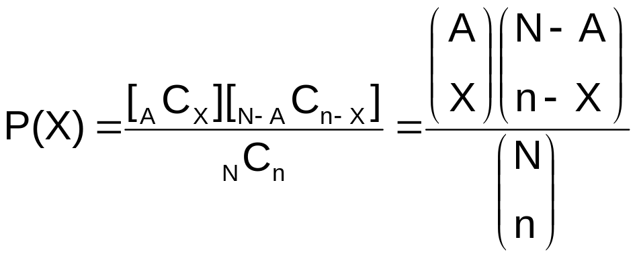
Hypergeometric Distribution Formula
Where
N = population size
A = number of items of interest in the population
N – A = number of events not of interest in the population
n = sample size
X = number of items of interest in the sample
n – X = number of events not of interest in the sample

Slide 47
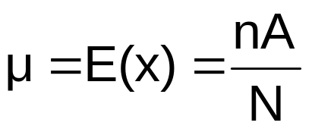
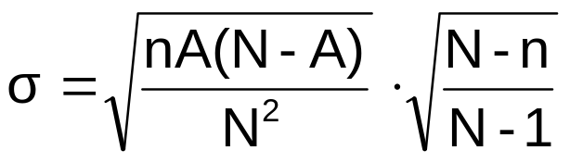
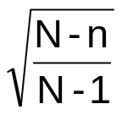
Properties of the
Hypergeometric Distribution
The mean of the hypergeometric distribution is
The standard deviation is
Where is called the “Finite Population Correction Factor”
from sampling without replacement from a
finite population

Slide 48
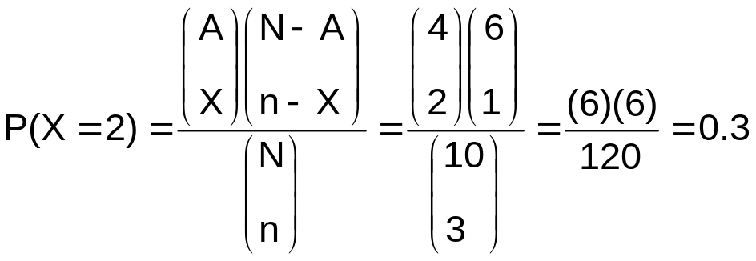
Using the
Hypergeometric Distribution
Example: 3 different computers are checked out from 10 in the department. 4 of the 10 computers have illegal software loaded. What is the probability that 2 of the 3 selected computers have illegal software loaded?
  N = 10 n = 3
  A = 4 X = 2
The probability that 2 of the 3 selected computers have illegal software loaded is 0.30, or 30%.

Slide 49
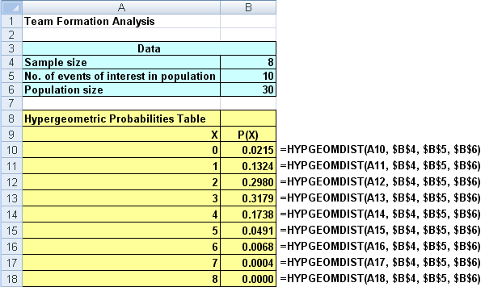
Using Excel for the
Hypergeometric Distribution

Slide 50
Chapter Summary
Addressed the probability distribution of a discrete random variable
Defined covariance and discussed its application in finance
Discussed the Binomial distribution
Discussed the Poisson distribution
Discussed the Hypergeometric distribution

